Slide 1
  本讲内容
关联规则
  Write-based、DFS算法
    VIPER
      Implement DFS with bitmap compression of data in vertical format
    FP-Growth算法
      Implement DFS using a tree structure in horizontal format
    FP-Growth based sub-graph mining

Slide 2
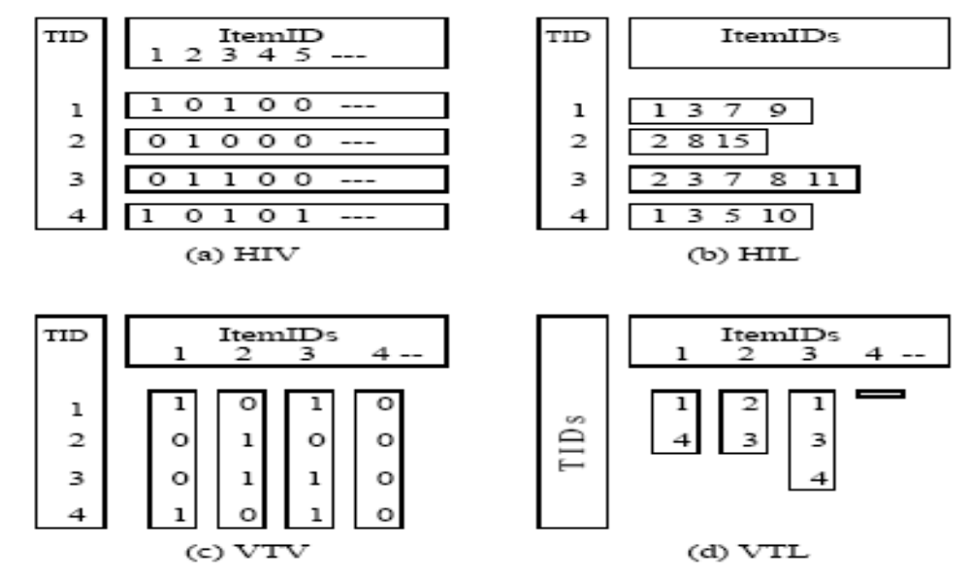
Comparison of Data Layouts

Slide 3

Vertical format for write-based FPM
Vertical format
a-TID
10
30
b-TID
20
30
40
c-TID
10
20
30
d-TID
10
TID | Items
10 | a, c, d
20 | b, c, e
30 | a, b, c, e
40 | b, e
to get TID list for {a,b} merge TID list for {a} and {b}
TID
30

Slide 4
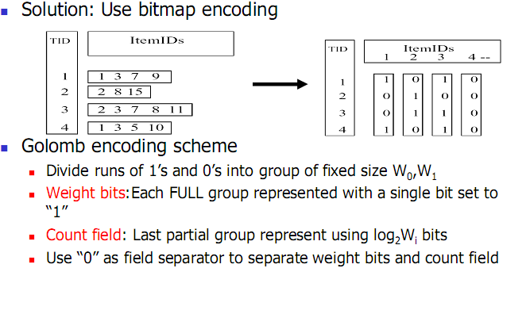
Vertical format for write-based FPM

Slide 5
  本讲内容
关联规则
  Write-based、DFS算法
    VIPER
      Implement DFS with bitmap compression of data in vertical format
    FP-Growth算法
      Implement DFS using a tree structure in horizontal format
    FP-Growth based sub-graph mining

Slide 6
FP-Growth算法
a,b,c,e
Depth-first search
Algorithm with write or point
a,b,e
a,b,e
a,c,e
b,c,e
a,b
a,c
a,e
b,c
b,e
c,e
a
b
c
e
{}

Slide 7
FP-Growth算法
a,b,c,e
Note that we can know the number of occurrence of “ab” by counting the number of “b” in the {a}-projected database !
a,b,e
a,b,e
a,c,e
b,c,e
TID | Items
30 | c, e
a,b
a,c
a,e
b,c
b,e
c,e
all rows that contain “ab”.
{ab}-projected database
a,b
TID | Items
10 | c, d
30 | b, c, e
a
a
b
c
e
all rows that contain “a”.
{a}-projected database
TID | Items
10 | a, c, d
20 | b, c, e
30 | a, b, c, e
40 | b, e
{}

Slide 8
FP-Growth算法
第一次扫描数据库：
类似于Apriori算法，找出频繁的1-itemset和他们的计 数值， 将频繁项目按频度降序排列
2. 第二次扫描数据库：
构造fp-tree （频度从大到小）
挖掘该树（频度从小到大）
注意：数据库大时，fp-tree可能在内存中装不下，需要
采取partition方法。

Slide 9
Construct FP-tree from a Transaction Database
TID Items bought (ordered) frequent items
100 {f, a, c, d, g, i, m, p} {f, c, a, m, p}
200 {a, b, c, f, l, m, o} {f, c, a, b, m}
300 {b, f, h, j, o, w} {f, b}
400 {b, c, k, s, p} {c, b, p}
500 {a, f, c, e, l, p, m, n} {f, c, a, m, p}
min_support = 3
{}
Header Table
Item frequency head
f 4
c 4
a 3
b 3
m 3
p 3
扫描数据库一遍，找到所有的频繁项目
将频繁项目按照降序排列，生成一个f-list
再扫描数据库一遍，构造FP-Tree
f:4
c:1
c:3
b:1
b:1
a:3
p:1
m:2
b:1
F-list=f-c-a-b-m-p
p:2
m:1

Slide 10
条件模式基
对所有的频繁项目，找到每一个项目在FP-Tree的所有前缀，构成每个项目的条件模式基（类似于条件或投影数据库，但去掉了部分不频繁的项目，如g，i等）
{}
Header Table
Item frequency head
f 4
c 4
a 3
b 3
m 3
p 3
f:4
c:1
Conditional pattern bases
item cond. pattern base
f
c f:3
a fc:3
b fca:1, f:1, c:1
m fca:2, fcab:1
p fcam:2, cb:1
c:3
b:1
b:1
a:3
p:1
m:2
b:1
p:2
m:1

Slide 11
递归构造条件模式基
用每一个项目的条件模式基作为输入，递归FP-Growth算法
p-conditional pattern base:
  fcam:2, cb:1
{}
Header Table
Item frequency head
f 4
c 4
a 3
b 3
m 3
p 3
f:4
c:1
Conditional pattern bases
item cond. pattern base
pc
{}
c:3
b:1
b:1


a:3
p:1
c:3
m:2
b:1
p-conditional FP-tree
p:2
m:1

Slide 12

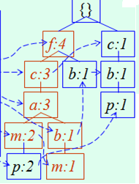
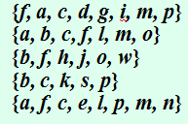
FP-Growth算法
包含p的递归到此结束，输出所有包含p的频繁项集：p, pc
pc
100 | c
400 | c
500 | c
pc
100 | fcam
400 | cb
500 | fcam
p
p
100 | f, c, a, m, p
200 | f, c, a, b, m
300 | f, b
400 | c, b, p
500 | f, c, a, m, p
{}

Slide 13
递归构造条件模式基
用每一个项目的条件模式基作为输入，递归FP-Growth算法
m-conditional pattern base:
  fca:2, fcab:1
{}
Header Table
Item frequency head
f 4
c 4
a 3
b 3
m 3
p 3
f:4
c:1
{}
Conditional pattern bases
item cond. pattern base
mf
mc f:3
ma fc:3
c:3
b:1
b:1

f:3

a:3
p:1
c:3
m:2
b:1
a:3
p:2
m:1
m-conditional FP-tree

Slide 14
递归构造条件模式基
用每一个项目的条件模式基作为输入，递归FP-Growth算法
ma-conditional pattern base:
  fc:3
{}
Header Table
Item frequency head
f 4
c 4
a 3
b 3
m 3
p 3
f:4
c:1
{}
Conditional pattern bases
item cond. pattern base
maf
mac f:3
c:3
b:1
b:1


f:3
a:3
p:1
m:2
b:1
c:3
p:2
m:1
ma-conditional FP-tree

Slide 15
递归构造条件模式基
用每一个项目的条件模式基作为输入，递归FP-Growth算法
mac-conditional pattern base:
  f:3
{}
Header Table
Item frequency head
f 4
c 4
a 3
b 3
m 3
p 3
f:4
c:1
{}
Conditional pattern bases
item cond. pattern base
macf
c:3
b:1
b:1

f:3

a:3
p:1
m:2
b:1
p:2
m:1
mac-conditional FP-tree

Slide 16
递归构造条件模式基
用每一个项目的条件模式基作为输入，递归FP-Growth算法
{}
Header Table
Item frequency head
f 4
c 4
a 3
b 3
m 3
p 3
f:4
c:1
All frequent patterns relate to m
m,
ma, mc, mf,
mac, maf, mcf,
macf
c:3
b:1
b:1

a:3
p:1
m:2
b:1
p:2
m:1

Slide 17
FP-Growth算法
接下来走b,a,c,f等分支…
算法结束时将获得所有的频繁项集
macf
mac
maf
mcf
pc
ma
mc
mf
p
m
{}

Slide 18
FP-Growth算法总结
构造FP-tree
  为了快速生成各个频繁集合的投影数据库，避免顺序扫描
挖掘FP-tree
  就是一个按照深度优先顺序生成投影数据库的过程。
  每一个需要为其生成投影数据库的集合，都是频繁集。不频繁集在构造FP-Tree时就过滤掉了
  当递归结束时，只要把所有的频繁集合并就是最后的所有频繁集

Slide 19
Benefits of the FP-tree Structure
Completeness
  Preserve complete information for frequent pattern mining
  Never break a long pattern of any transaction
Compactness
  Reduce irrelevant info—infrequent items are gone
  Items in frequency descending order: the more frequently occurring, the more likely to be shared
  Never be larger than the original database (not count node-links and the count field)
  For Connect-4 DB, compression ratio could be over 100

Slide 20
Partition Patterns and Databases
Frequent patterns can be partitioned into subsets according to f-list
  F-list=f-c-a-b-m-p
  Patterns containing p
  Patterns having m but no p
  …
  Patterns having c but no a nor b, m, p
  Pattern f
Completeness and non-redundency

Slide 21

FP-Growth vs. Apriori: Scalability With the Support Threshold
Data set T25I20D10K

Slide 22
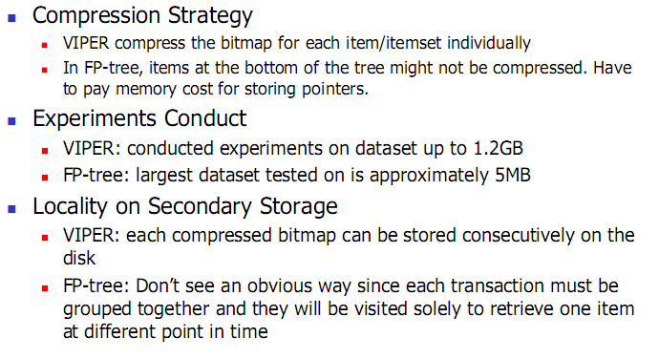
VIPER vs. FP-Growth: Comparision

Slide 23
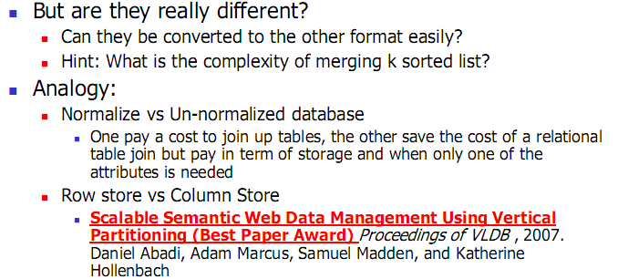
VIPER vs. FP-Growth: Comparision

Slide 24
Why would write-based algorithms be faster ?
Read-based FPM algorithms like Apriori algorithm which will “forget” its previous processing. Eg. let the frequent itemset {a,b,c,d,e} be frequent. Let ‘s look at a record containing {a,b,c}.
Level Candidate Record
1-itemset {a} {TID=10: a, b, c}
2-itemset {a,b} {TID=10: a, b, c}
3-itemset {a,b,c} {TID=10: a, b, c}
Write-based FPM avoid this repeated scanning by doing depth first search
scanned
scanned
scanned
Level Candidate Record
1-itemset {a} {TID=10: a, b, c}
2-itemset {a,b} {TID=10: b, c}
3-itemset {a,b,c} {TID=10: c}

Slide 25
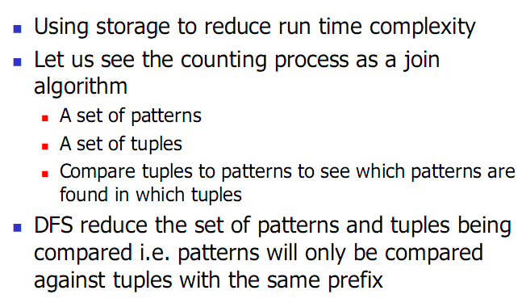
Why would write-based algorithms be faster ?

Slide 26
However......
a,b,c,e
Write-based algorithm usually pay a higher cost in term of space complexity.
Projected databases are materialize for all the red circles on the way to getting the {a,b} projected database.
a,b,e
a,b,e
a,c,e
b,c,e
TID | Items
30 | c, e
a,b
a,c
a,e
b,c
b,e
c,e
all rows that contain “ab”.
{ab}-projected database
a,b
TID | Items
10 | c, d
30 | b, c, e
a
a
b
c
e
all rows that contain “a”.
{a}-projected database
TID | Items
10 | a, c, d
20 | b, c, e
30 | a, b, c, e
40 | b, e
{}

Slide 27
TID | Items
10 | a, c, d, f
20 | b, c, e
30 | a, b, c, e
40 | b, e
e
a
b
c
TID | Items
10 | c, d
30 | b, c, e
TID | Items
20 | c, e
30 | c, e
40 | e
TID | Items
20
30
40
TID | Items
10 | d,f
20 | e
30 | e
ab
ac
ae
TID | Items
30 | c, e
TID | Items
10 | d
30 | e
TID | Items
30 | e
abc
abe

Slide 28
No candidates ?
There are claims that write-based algorithm are faster because they don’t generate candidates. This is not true in general. Example, if minsup is 30%, then all the items in the {a}-projected database are false candidates ! (i.e. {a,b}, {a,c}, {a,d}, {a,e}, {a,f} and {a,g} are never frequent
TID | Items
10 | a, c, d
20 | b, c, e
30 | a, b, c, e
40 | a, f
50 | b,c
60 | a,g
70 | f, g,
80 | e, g
90 | a,b ,g
100 | b, e
TID | Items
10 | c, d
30 | b, c, e
40 | f
60 | g
90 | b, g
{a}-projection

Slide 29
So far, we covered
 | Read-based | Write-based | Point-based
Association Mining | Apriori[AgSr94] | VIPER[SHSB00] FPGrowth [HaPe00]
Sub-Graph Mining | AGM[PKDD’00] FSG[ICDM’01] | Mofa[ICDM’02] gSpan[ICDM’02]
Sequential Pattern Discovery | GSP[AgSr96] | PrefixSpan [PHPC01]
Iceberg Cube | Apriori[AgSr94] |  | BUC[BeRa99], H-cubing [HPDW01]

Slide 30
  本讲内容
关联规则
  Write-based、DFS算法
    VIPER
      Implement DFS with bitmap compression of data in vertical format
    FP-Growth算法
      Implement DFS using a tree structure in horizontal format
    FP-Growth based sub-graph mining

Slide 31
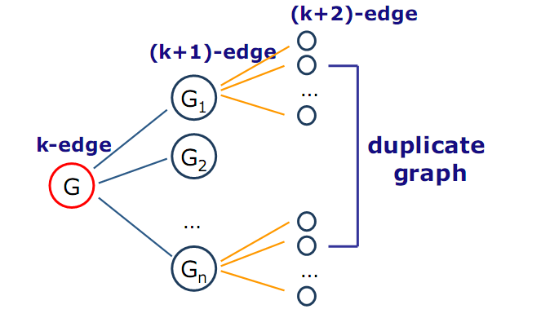
Sub-Graph Mining---pattern growth method

Slide 32
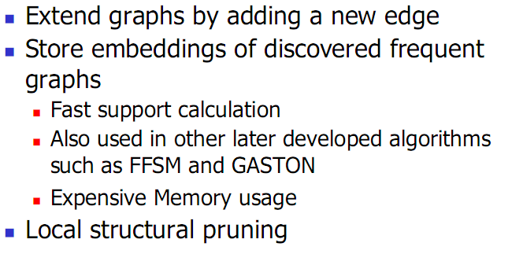
Mofa (ICDM’02)

Slide 33
gSpan (Yan & Han, ICDM’02)
K edges
(K-1) edges
Enumerate G0
in the graph dataset;
At the same time,
Count the frequency
of G1, G2, … Gn.
G1
G0
G2
…
Gn
Output Frequent Ones
in G1, G2, …, Gn.
Notes:
Apriori:
Step1: Join two k-1 edge graphs (these two graphs share a same k-2 edge subgraph) to generate a k-edge graph
Step2: Join the tid-list of these two k-1 edge graphs, then see whether its count is larger than the minimum support
Step3: Check all k-1 subgraph of this k-edge graph to see whether all of them are frequent
Step4: After G successfully pass Step1-3, do support computation of G in the graph dataset, See whether it is really frequent.
gSpan:
Step1: Right-most extend a k-1 edge graph to several k edge graphs.
Step2: Enumerate the occurrence of this k-1 edge graph in the graph dataset, meanwhile, counting these k edge graphs.
Step3: Output those k edge graphs whose support is larger than the minimum support.
Pros:
1: gSpan avoid the costly candidate generation and testing some infrequent subgraphs.
2: No complicated graph operations, like joining two graphs and calculating its k-1 subgraphs.
3. gSpan is very simple
The key is how to do right most extension efficiently in graph. We invented DFS code for graph.

Slide 34
gSpan (cont.)
gSpan extends a k-edge graph to a (k+1)-edge graph by adding one edge
gSpan chooses only one depth-first search tree in a graph which produces the minimum DFS code, the canonical label of the graph
gSpan only adds new edges on the vertices along the right-most path of the depth-first search tree

Slide 35
Right-Most Extension
0
0
1
1
2
2
3
5
3
5
4
4
(a)
(b)
Backward-edge extension
Notes:
1: Given a graph in (a), suppose, the DFS traverse the graph in the order 0, 1, 2, 3, 4
2: The vertices 0, 1, 2 and 4 constitute the right-most path, and vertex 4 is called the right-most vertex (the last discovered vertex)
3: Any extension must take place on the right-most path: first, the backward edge can only extend from the right most vertex;
Second, the forward edge can extend from any vertices on the right-most path.
4: The extension of a graph is equal to the extension of its DFS code by appending a new edge in the end.

Slide 36
Right-Most Extension (cont.)
0
0
1
1
2
2
3
5
3
5
4
4
(a)
(b)
Forward-edge extension
Notes:
1: Given a graph in (a), suppose, the DFS traverse the graph in the order 0, 1, 2, 3, 4
2: The vertices 0, 1, 2 and 4 constitute the right-most path, and vertex 4 is called the right-most vertex (the last discovered vertex)
3: Any extension must take place on the right-most path: first, the backward edge can only extend from the right most vertex;
Second, the forward edge can extend from any vertices on the right-most path.
4: The extension of a graph is equal to the extension of its DFS code by appending a new edge in the end.

Slide 37
Avoid Duplicate Extension
(1)
(2)
(2)
(1)
They are the same graph, but they grow in different ways.
The cost to detect them is huge if there are lots of such
duplicate growths.

Slide 38
Right-most Extension
(1)
(2)
(2)
(1)
(1)
Theorem:
  Any graph can be grown by right-most extension
We will never generate this

Slide 39
Search Space in gSpan
1-edge
...
2-edge
...
G
...
...
G1
...
Gn
3-edge
...
...
...

Slide 40
DFS Code
Flatten a graph into a sequence such that any
right-most extension takes place in the end of
the sequence.
e0: (0,1,X,a,X)
X
a
b
e1: (1,2,X,a,Y)
X
c
a
e2: (2,0,Y,b,X)
Y
d
b
e3: (2,3,Y,b,Z)
Z
Z
e4: (3,1,Z,c,X)
e5: (2,4,Y,d,Z)
Notes:
1: Show how to construct a DFS code, which is related with right most extension
2: One graph has lots of DFS code, among them, there is a minimum DFS code. We invent a DFS lexicographic ordering system.
Among this ordering, we take minimum DFS code as canonical label.

Slide 41
DFS Code (cont.)
We call a graph with a DFS tree subscripted by subscripted graph
DFS Code ←→ subscripted graph
Actually, the construction of DFS Code is a right-most extension procedure to extend a graph
We call a subscripting which can generate the minimum DFS code by a base subscripting
We only conduct right-most extension on this base subscriptig
Base subscripting + one edge right-most extension MAY NOT be another base subscripting

Slide 42
Reduce the Number of G1, … Gn
0
1
2
3
5
4
#= 6 + 10 =16

Slide 43
Right-Most Extension (cont.)
Number of Extensions = 16
right-most extension
Number of Extensions = 6

Slide 44
So far, we covered
 | Read-based | Write-based | Point-based
Association Mining | Apriori[AgSr94] | VIPER[SHSB00] FPGrowth [HaPe00]
Sub-Graph Mining | AGM[PKDD’00] FSG[ICDM’01] | Mofa[ICDM’02] gSpan[ICDM’02]
Sequential Pattern Discovery | GSP[AgSr96] | PrefixSpan [PHPC01]
Iceberg Cube | Apriori[AgSr94] |  | BUC[BeRa99], H-cubing [HPDW01]

Slide 45
PrefixSpan: Example of Write-based Method
SDB
SID | sequence
10 | <a(abc)(ac)d(cf)>
20 | <(ad)c(bc)(ae)>
30 | <(ef)(ab)(df)cb>
40 | <eg(af)cbc>
Length-1 sequential patterns
<a>, <b>, <c>, <d>, <e>, <f>
Having prefix <a>
Having prefix <c>, …, <f>
Having prefix <b>
<a>-projected database
<(abc)(ac)d(cf)>
<(_d)c(bc)(ae)>
<(_b)(df)cb>
<(_f)cbc>
<b>-projected database
…
Length-2 sequential
patterns
<aa>, <ab>, <(ab)>,
<ac>, <ad>, <af>
… …
Having prefix <aa>
Having prefix <af>
<aa>-proj. db
…
<af>-proj. db

Slide 46
So far, we covered
 | Read-based | Write-based | Point-based
Association Mining | Apriori[AgSr94] | VIPER[SHSB00] FPGrowth [HaPe00]
Sub-Graph Mining | AGM[PKDD’00] FSG[ICDM’01] | Mofa[ICDM’02] gSpan[ICDM’02]
Sequential Pattern Discovery | GSP[AgSr96] | PrefixSpan [PHPC01]
Iceberg Cube | Apriori[AgSr94] |  | BUC[BeRa99], H-cubing [HPDW01]

Slide 47
References
[AgSr94] R. Agrawal, R. Srikant, “Fast Algorithms for Mining Association Rules”, Proc. of the 20th Int'l Conference on Very Large Databases, Santiago, Chile, Sept. 1994.
[AgSr96] R. Srikant, R. Agrawal: "Mining Sequential Patterns: Generalizations and Performance Improvements", to appear in Proc. of the Fifth Int'l Conference on Extending Database Technulogy (EDBT), Avignon, France, March 1996.
[BeRa99] Kevin S. Beyer and Raghu Ramakrishnan. “Bottom-Up Computation of Sparse and Iceberg CUBEs”. In Proceedings of the ACM SIGMOD International Conference on Management of Data, pages 359-370, June 1999.
[HPDW01] J. Han, J. Pei, G. Dong, and K. Wang, “Efficient Computation of Iceberg Cubes with Complex Measures”, Proc. 2001 ACM-SIGMOD Int. Conf. on Management of Data (SIGMOD'01), Santa Barbara, CA, May 2001.
[HPY00] J. Han, J. Pei, and Y. Yin, `` Mining Frequent Patterns without Candidate Generation'',, Proc. 2000 ACM-SIGMOD Int. Conf. on Management of Data (SIGMOD'00), Dallas, TX, May 2000.
[HaPe00] J. Han and J. Pei ``Mining Frequent Patterns by Pattern-Growth: Methodology and Implications '', ACM SIGKDD Explorations (Special Issue on Scaleble Data Mining Algorithms), 2(2), December 2000.
[PHPC01] J. Pei, J. Han, H. Pinto, Q. Chen, U. Dayal, and M.-C. Hsu, “ PrefixSpan: Mining Sequential Patterns Efficiently by Prefix-Projected Pattern Growth'', Proc. 2001 Int. Conf. on Data Engineering (ICDE'01), Heidelberg, Germany, April 2001.

Slide 48
References
[SHSB00] P.Shenoy, J. Haritsa, S. Sudarshan, G. Bhalotia, M. Bawa, D. “Turbo-Charging Vertical Mining of Large Database.” Proc. 2000 ACM-SIGMOD Int. Conf. on Management of Data (SIGMOD'00), Dallas, TX, May 2000.
[Zaki98] Mohammed J. Zaki, “Efficient Enumeration of Frequent Sequences”, 7th International Conference on Information and Knowledge Management, pp 68-75, Washington DC, November 1998.
[Zaki00] Mohammed J. Zaki, “Scalable Algorithms for Association Mining”, in IEEE Transactions on Knowledge and Data Engineering, Vol. 12, No. 3, pp 372-390, May/June 2000.
[Zaki01] Mohammed J. Zaki, “SPADE: An Efficient Algorithm for Mining Frequent Sequences”, in Machine Learning Journal, special issue on Unsupervised Learning (Doug Fisher, ed.), pp 31-60, Vol. 42 Nos. 1/2, Jan/Feb 2001.

